Slide 1
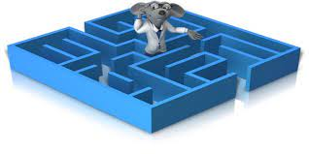
DAA PROJECT
RAT IN A MAZE
A MINOR PROJECT

Slide 2
PROBLEM STATEMENT
1.The rat in a maze problem is one of the famous
backtracking problems.
2. A rat starts from source and has to reach the destination.
3. Different paths a rat can move from source to destinations
is found in this problem.
4. A rat can move only in 2 directions forward and
downward.

Slide 3
PROBLEM EXPLANATION WITH DIAGRAM AND EXAMPLE:
• A Maze is given as N*N binary matrix of blocks where source block is the upper left most block i.e., maze [0][0] and destination block is lower rightmost block i.e., maze[N-1][N-1]. A rat starts from source and has to reach the destination. The rat can move only in two directions: forward and down.
• In the maze matrix, 0 means the block is a dead end and 1 means the block can be used in the path from source to destination. Note that this is a simple version of the typical Maze problem. For example, a more complex version can be that the rat can move in 4 directions and a more complex version can be with a limited number of moves.

Slide 4
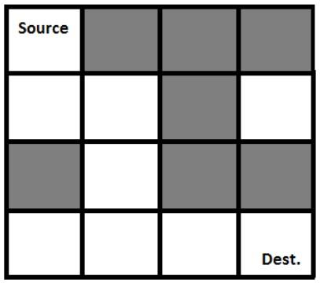
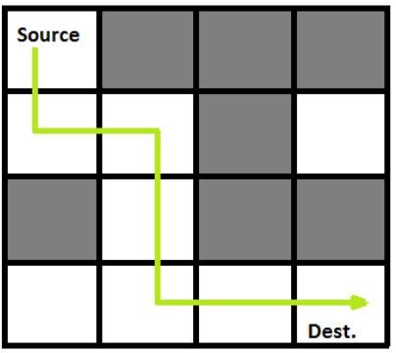
INPUT
Following is a binary matrix representation of the maze.
{1, 0, 0, 0}
{1, 1, 0, 1}
{0, 1, 0, 0}
{1, 1, 1, 1}
OUTPUT
Following is the solution matrix (output of program) for the
above input matrix.
{1, 0, 0, 0}
{1, 1, 0, 0}
{0, 1, 0, 0}
{0, 1, 1, 1}
All entries in solution path are marked as 1.

Slide 5
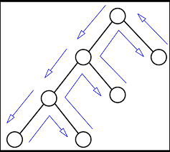
DESIGN TECHNIQUES USED
Backtracking:
Backtracking is an algorithmic-technique for solving problems recursively by trying to build a solution incrementally. Solving one piece at a time, and removing those solutions that fail to satisfy the constraints of the problem at any point of time (by time, here, is referred to the time elapsed till reaching
any level of the search tree) is the process of backtracking

Slide 6
Backtracking technique is used in this problem.
Approach: Form a recursive function, which will follow a path and check if the path reaches the destination or not. If the path does not reach the destination, then backtrack and try other paths.
Algorithm:
Create a solution matrix, initially filled with 0’s.
2.Create a recursive function, which takes initial matrix, output matrix and position of rat (i, j).
3. if the position is out of the matrix or the position is not valid then return.
4. Mark the position output[i][j] as 1 and check if the current position is destination or not. If destination is reached print the output matrix and return.
5. Recursively call for position (i-1,j), (I,j-1), (i+1, j) and (i, j+1).
6. Unmark position (i, j), i.e., output[i][j] = 0.

Slide 7
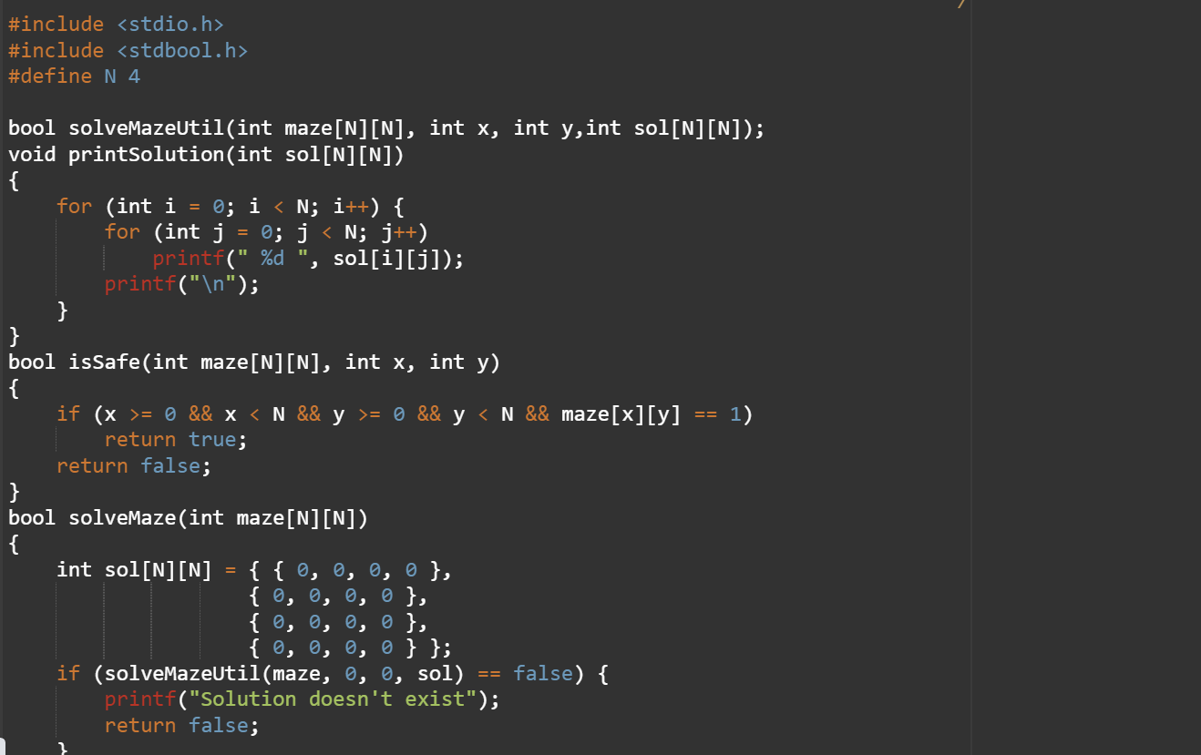
SOURCE CODE -

Slide 8
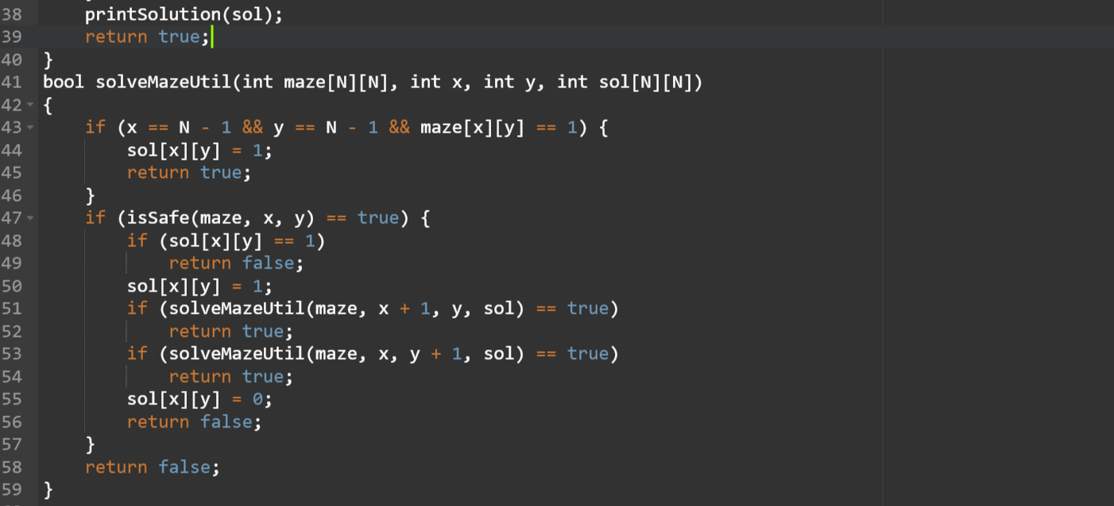

Slide 9
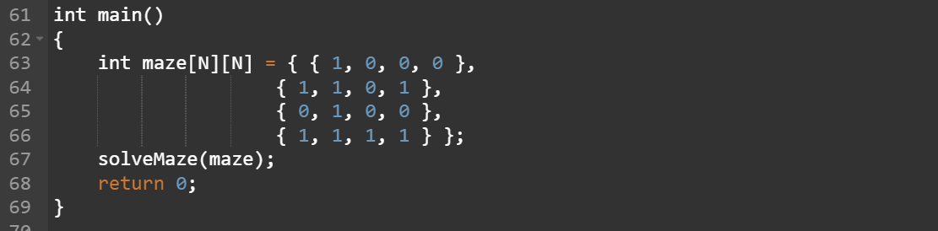
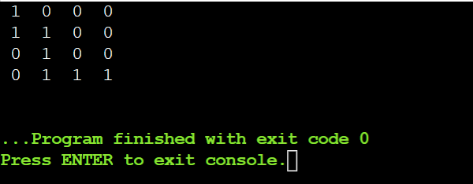
OUTPUT -

Slide 10
COMPLEXITY ANALYSIS -
• Time Complexity: O(2^(n^2)).
The recursion can run upper-bound 2^(n^2) times.
• Space Complexity: O(n^2).
Output matrix is required so an extra space of size n*n
is needed.
CONCLUSION -
We have created a solution for a real-life scenario completely from scratch. It helps us to write logic and maintain clean structure in code. This helps in creating solutions for real time problems in our day-to-day life.

Slide 11
THANK YOU
SUBMITTED BY :-
p.INDIVAR – RA2011042010107
G,PRUDHVIJA – RA2011042010126
E.REVANTH - RA2011042010133

